Slide 1

Project name:-Cinema Compass
DATE:-27/12/2024
TEAM MEMBERS:
Name | Roll No | Roll
Karthik B | 24AD093 | Presentation
Jeevaanadh | 24AD084 | CSS,GITHUB
Jai Avinash | 24AD073 | HTML
Mohamed naufal | 24AD0125 | JAVASCRIPT
WEB-WEAVERS:-CREATEATHON

Slide 2


PROBLEM STATEMENT :
The goal of the project is to create an engaging and user-friendly platform for showcasing, rating, and reviewing movies. The problem addressed is the lack of a centralized and interactive hub for movie enthusiasts to explore content, share opinions, and rate movies.
PAGE
02/15

Slide 3




STUDIO SHODWE
SOLUTION OVERVIEW
Our solution is an Interactive Movie Blog featuring:
1. A visually appealing movie gallery with detailed descriptions.
2. Rating functionality for user engagement.
3. A review system for community interaction.
PAGE
03/15

Slide 4

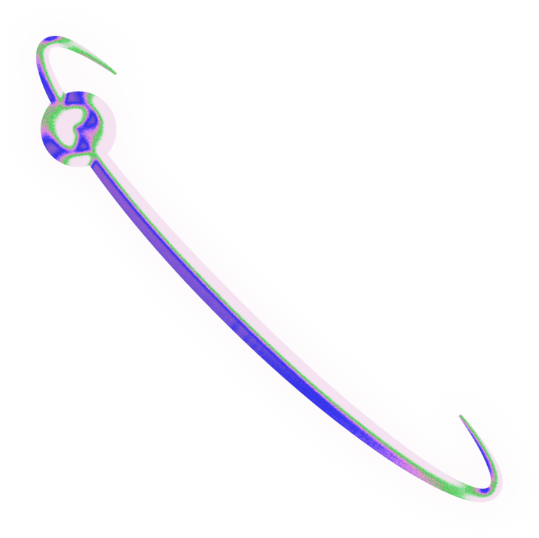
STUDIO SHODWE
Dynamic movie gallery displaying half-sized portraits alongside detailed descriptions.
Review section with a text area for personalized feedback.
User rating system for individual movies with a range of 0-10.
FEATURES & FUNCTIONALITY
Responsive design optimized for all devices.
Modern and accessible dark theme.
PAGE
04/15

Slide 5
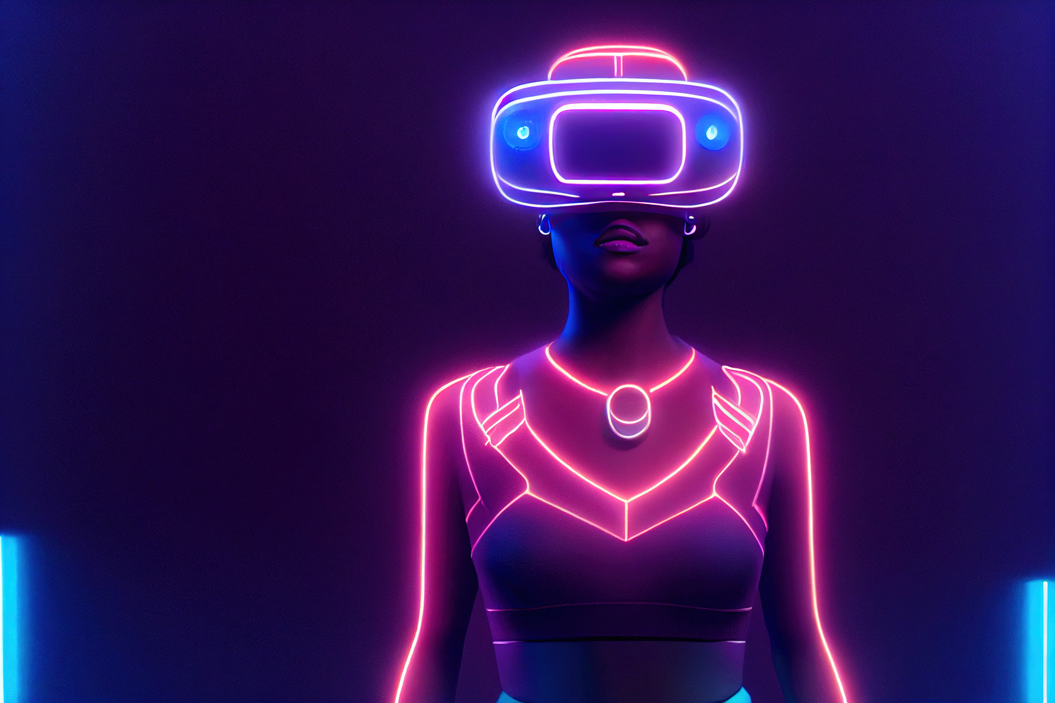
STUDIO SHODWE
TECHNICAL DETAILS
HTML5 and CSS3 for structure and styling.
HTML5
and CSS3
Design
Flexbox and Grid Layout for responsive design.
Compatibility
Compatibility with all modern browsers.
PAGE
05/15

Slide 6
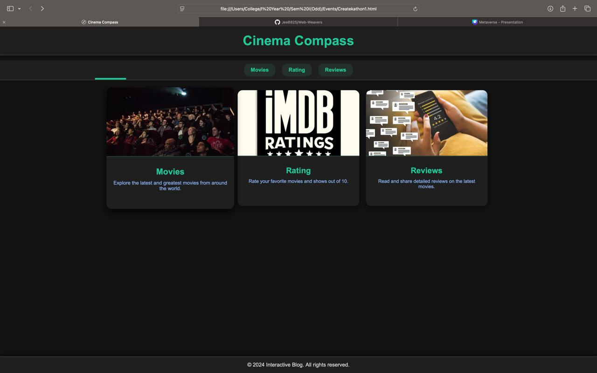
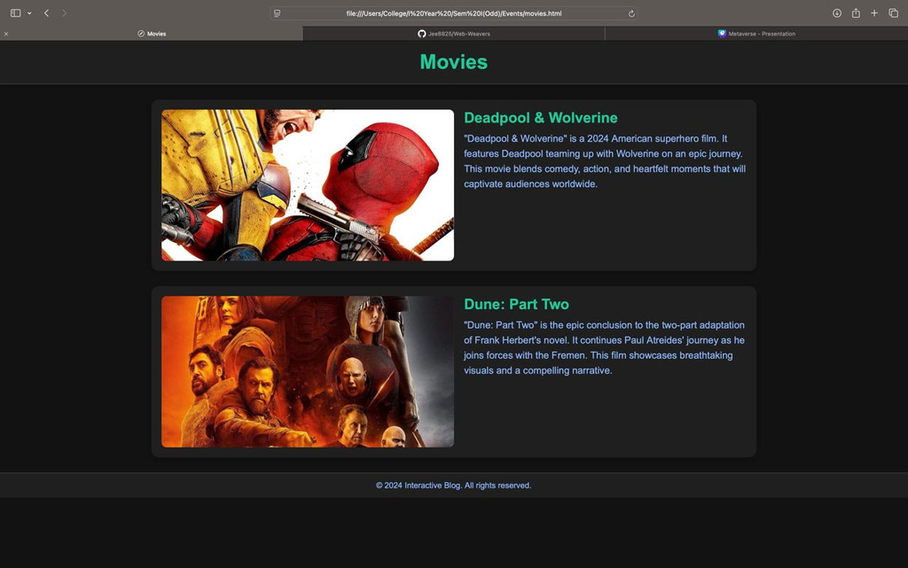

USER INTERFACE
6AGE
06/15

Slide 7
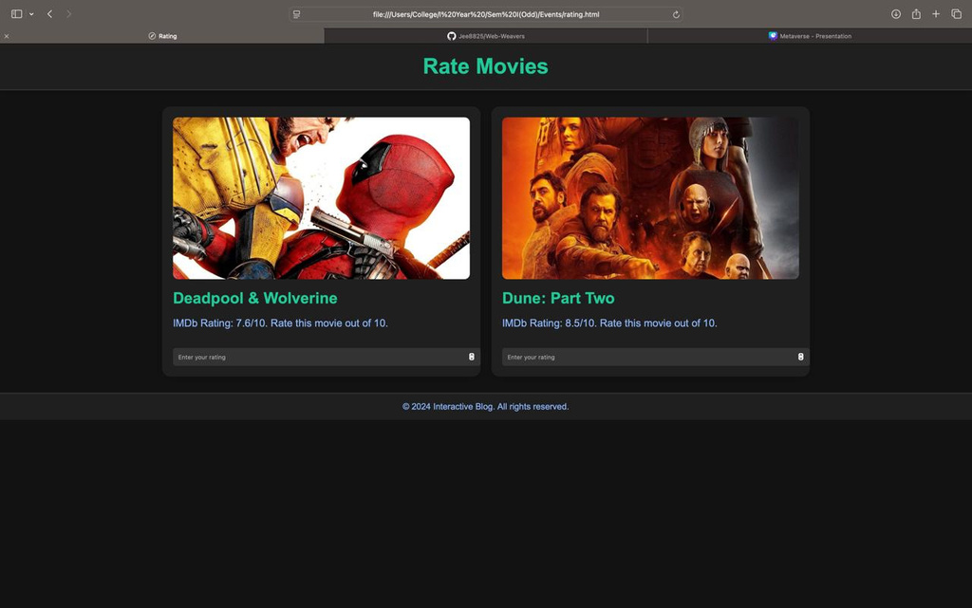
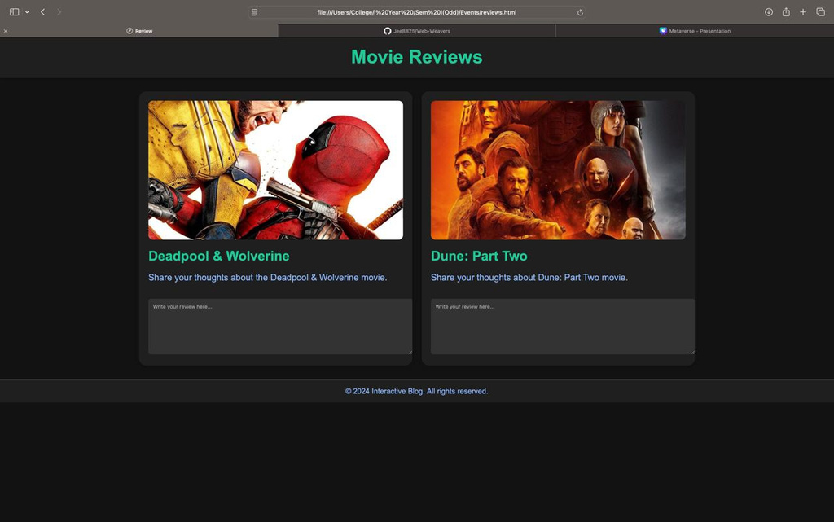
USER INTERFACE

Slide 8
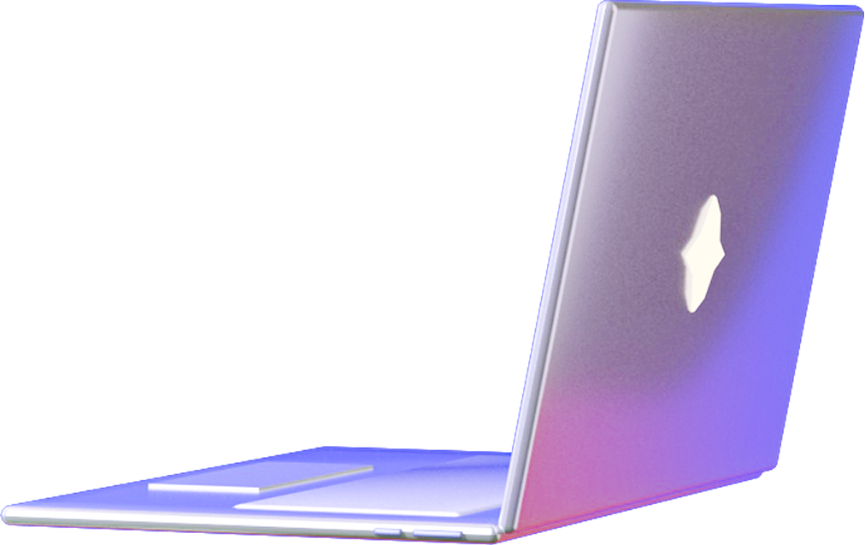
IMPLEMENTATION
Content
Process: Designed and structured the gallery layout using flexbox for text flexibility and portrait image scaling.
Challenges
1. Ensuring responsiveness for various screen sizes.
2. Balancing text visibility with image scaling.
Solution
Leveraged flex: auto and object-fit CSS properties for adaptive layouts.
6AGE
07/15

Slide 9
GIT REPOSITORY
CINEMA COMPASS
https://github.com/Jee8825/Web-Weavers.git
6AGE
08/15

Slide 10

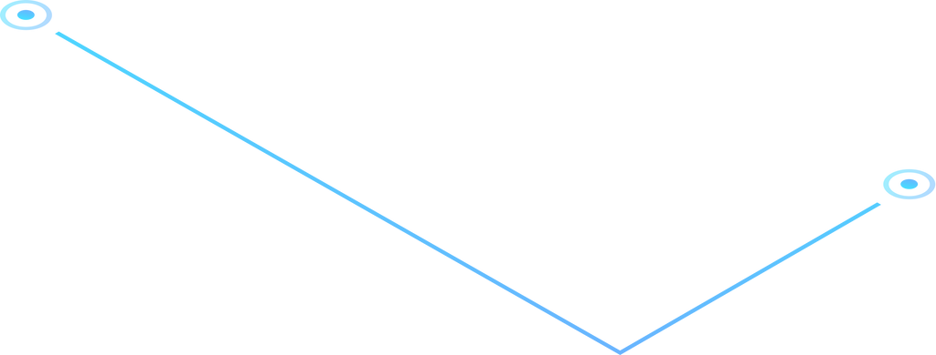
Q&A
SESSION

Slide 11

THANK YOU!

